Slide 1
Banks & Credit Unions
AI orchestration for community banks, regional banks & credit unions — powered by the #1 iPaaS
Notes:
Slide Structure:
Slide 1: Title + Hook
Title: "Accelerating Banking Operations with AI & Automation"
Subtitle: [Prospect Bank Name] + Workato
Visual: Banking imagery (not stock handshake clichés)
Script: "Thanks for the time today. I want to share how leading banks are using automation to transform loan processing, compliance, and customer experience..."
Slide 2: The Challenge (Industry-Specific)
Headline: "Banks Are Caught Between Growth Pressure and Operational Complexity"
Content (3 visual stats):
📉 "Customer expectations: Same-day loan decisions"
⚠️ "Reality: 7-14 day processing times, 23% abandonment"
💰 "Impact: $4.2M in lost revenue annually for mid-size banks"
Visual: Icons + brief stats (not bullet points)
Script: "What we're hearing from banks like yours: customers expect instant decisions, but manual processes across Salesforce, your LOS, and core banking create bottlenecks..."
Slide 3: The Workato Approach (Solution Framework)
Headline: "Orchestrate Data, Systems & AI Across Your Banking Operations"
Content (3 capability pillars with icons):
🔗 Connect Everything: 1200+ connectors (Salesforce, nCino, Temenos, SAGE, Guidewire)
🤖 Add Intelligence: AI agents for underwriting, fraud checks, compliance
⚡ Empower Teams: Business users build workflows, not just IT
Visual: Simple architecture diagram showing systems flowing through Workato
Script: "Workato sits in the middle, orchestrating data between your CRM, loan origination, core banking, and compliance systems. Your business teams can build and modify these workflows without waiting on IT..."
Slide 4: Proof (Customer Success Snapshot)
Headline: "[Similar Bank/Credit Union] Achieved These Results in 6 Months"
Content (Before/After metrics):
Loan processing: 7 days → 4 hours ⚡
Cost per loan: $450 → $180 💰
Compliance violations: 12 → 0 ✅
FTE redeployed: 15 employees to customer service 👥
Visual: Customer logo + headshot + quote (if approved)
Quote: "Workato gave us the agility to launch new products without rip-and-replace." - VP Digital Banking
Script: "Here's a credit union similar to you in size and tech stack. They were struggling with the same loan processing bottleneck. After implementing Workato..."
Slide 5: Next Steps (Clear CTA)
Headline: "Let's Explore What's Possible for [Prospect Name]"
Content:
✓ Discovery Workshop (2 hours): Map your loan origination process
✓ Value Assessment (1 week): Quantify your automation opportunity
✓ Pilot Use Case (30 days): Prove ROI with one workflow
Visual: Simple timeline graphic
CTA: "Can we schedule a 2-hour workshop with your lending and IT teams?"
Script: "I'd love to do a deeper dive on your specific environment. We typically start with a discovery workshop where we map your current loan process, identify automation opportunities, and build a business case..."
Customization Zones for Partners/Sellers:
Slide 1: Add partner logo (if GSI co-sell)
Slide 2: Swap industry stats (use different challenge if prospect cares more about compliance than loans)
Slide 4: Change customer proof to closest match (community bank vs. regional bank vs. credit union)

Slide 2


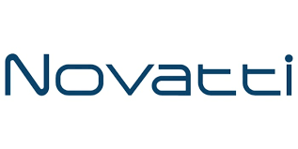

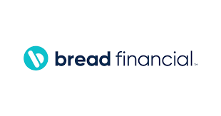
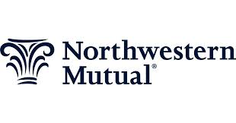
Accounts opened.
Loans approved.
Customers answered.
Work done!
Notes:
Top vertical segment messaging

Slide 3
The pressure on community banks is real.
Enterprise Agility: 68% of bank CTOs say legacy systems block AI deployment (EY Financial Services). FinTechs onboard customers in minutes. Your members now expect the same — on a Jack Henry or Fiserv core that wasn't built for that. Efficiency & OrCA: The average community bank spends 3 FTEs per 100 loan applications on manual processing. Lightbulb Credit automated 300-400K monthly credit bureau tasks with zero additional headcount. That's what OrCA consumption-based scaling delivers. Risk Reduction: $270B spent annually on financial services compliance (Deloitte). One failed BSA exam can cost more than your entire IT budget. Automated audit trails aren't optional — they're existential. Revenue Growth: 60% of loan applicants abandon if the process takes more than 5 minutes. Gen-Z first-time credit buyers don't call — they click away. The banks winning this generation are the ones where the experience matches the expectation.
60% of loan applicants abandonif the process takes more than 5 minutes. Your competitors have already fixed this.
Notes:
Align with Value drivers of WSS.
—--------
Discover time - what are you needed to solve??

Slide 4
Built for the banking & credit union tech stack
Enterprise MCP Server Templates
Turn core banking workflows into governed MCP servers. AI agents with auditable access to loan, member & compliance data. HIPAA BAA. SOC 2 Type II. Zero Downtime Upgrades.
AI Genies
KYC Genie | Support Genie | CX Genie | Compliance Reporting Genie | Loan Origination Genie | Fraud Alert Genie
Core Banking Connectors
Jack Henry (Silverlake, Symitar, CIF2020) | Fiserv | FIS | Finastra | Q2 | Corelation | CSI | nCino | Salesforce FSC | Workday | Snowflake | Socure | Alloy | Equifax | Experian | DocuSign | ADP | ServiceNow | LexisNexis | Broadridge
Notes:
How do we fit into the Banking ecosystem.
Connectors - Orchestration out

Slide 5
Four priorities. Immediate results.
Loan Origination & Digital Onboarding
KYC/AML Compliance Automation
Core Banking Modernization
24/7 AI-Powered Member Support

Slide 6
Use Case: Loan Origination & Digital Onboarding
Current: 7-14 days, 3 FTEs per 100 applications, 23% abandonment, $4.2M annual revenue loss. Target: Same-day decisioning, 60% cost reduction, 85% abandonment reduction.

Slide 7
Why Workato for Banks & Credit Unions

Slide 8
Community banks & credit unions running on Workato
Fortis Bank
Regional commercial bank: compliance, lending & IT automated $202K ARR • 305 active recipes • Broadridge + LexisNexis + WFA + Data Integration + Event Streams + SCIM + APIM all active • Enterprise-wide automation across compliance, lending, and IT operations
Credit Human CU
Credit union loan origination fully automated $73K ARR • JHA Symitar + Equifax + DocuSign connected • Loan application to funded in hours • On-prem agent connects Symitar to cloud apps without replacing the core
Paragon Bank
Legacy IBMi (AS/400) connected to the cloud via on-prem agent $277K ARR • IBM iSeries connected to OutSystems and APIM • Core modernization running in parallel without rip-and-replace • “Workato is essential for switching from one core to the next.” — Regional Bank CIO (NDA)
Notes:
Links to each of the customer reference packages.

Slide 9
Fortis Bank: 305 Recipes Connecting Compliance, Lending & IT
Challenge: Regional commercial bank needed to connect Broadridge (securities), LexisNexis (AML/KYC), and operational systems without a large integration team or custom development. Outcomes: $202K ARR • 305 active recipes in production • WFA + Data Integration + Event Streams + SCIM + APIM all active • Compliance, lending, and IT operations automated across multiple lines of business • Audit Streaming provides complete trail for regulatory examiners. Workato how: Broadridge (securities clearing) + LexisNexis (identity/AML) connected via Workato → Event Streams for real-time data → SCIM for user provisioning → APIM for internal API management. SCALE differentiator: OrCA + Federated Model.

Slide 10
Credit Human CU: Loan Origination from Application to Funded — Automated
Challenge: Credit union running JHA Symitar needed to connect its core to Equifax (credit bureau) and DocuSign (closing documents) without custom middleware that would break on every core upgrade. Outcomes: $73K ARR • JHA Symitar + Equifax + DocuSign fully orchestrated • Loan application to funded without manual handoffs • APIM active for internal API governance • Community bank team operates independently without IT dependency. Workato how: On-prem agent connects Symitar → Workato orchestrates credit bureau pull (Equifax) → underwriting decisioning → DocuSign closing package → member notification. SPEED differentiator: API People partnership for Symitar connector — live on day one, not built from scratch.

Slide 11
GXS Bank (Singapore): Full Digital Bank Stack Orchestrated on Workato
Challenge: Greenfield digital bank in Singapore needed to connect identity, security, member provisioning, and digital banking platforms from day one — without legacy constraints. Outcomes: $163K ARR • 210 active recipes • 2 BUs • Adobe Sign + AWS + CrowdStrike Falcon + Firebase + SCIM + Workbot + Audit Streaming + GXS AWS SES all active • Full digital bank operations orchestrated on one platform from launch. Workato how: Identity and access (SCIM) + security (CrowdStrike) + document signing (Adobe Sign) + communications (AWS SES) + member automation (Workbot) all running through Workato. POWER differentiator: Enterprise Security + Zero Data Logging + Audit Streaming for MAS regulatory compliance.

Slide 12









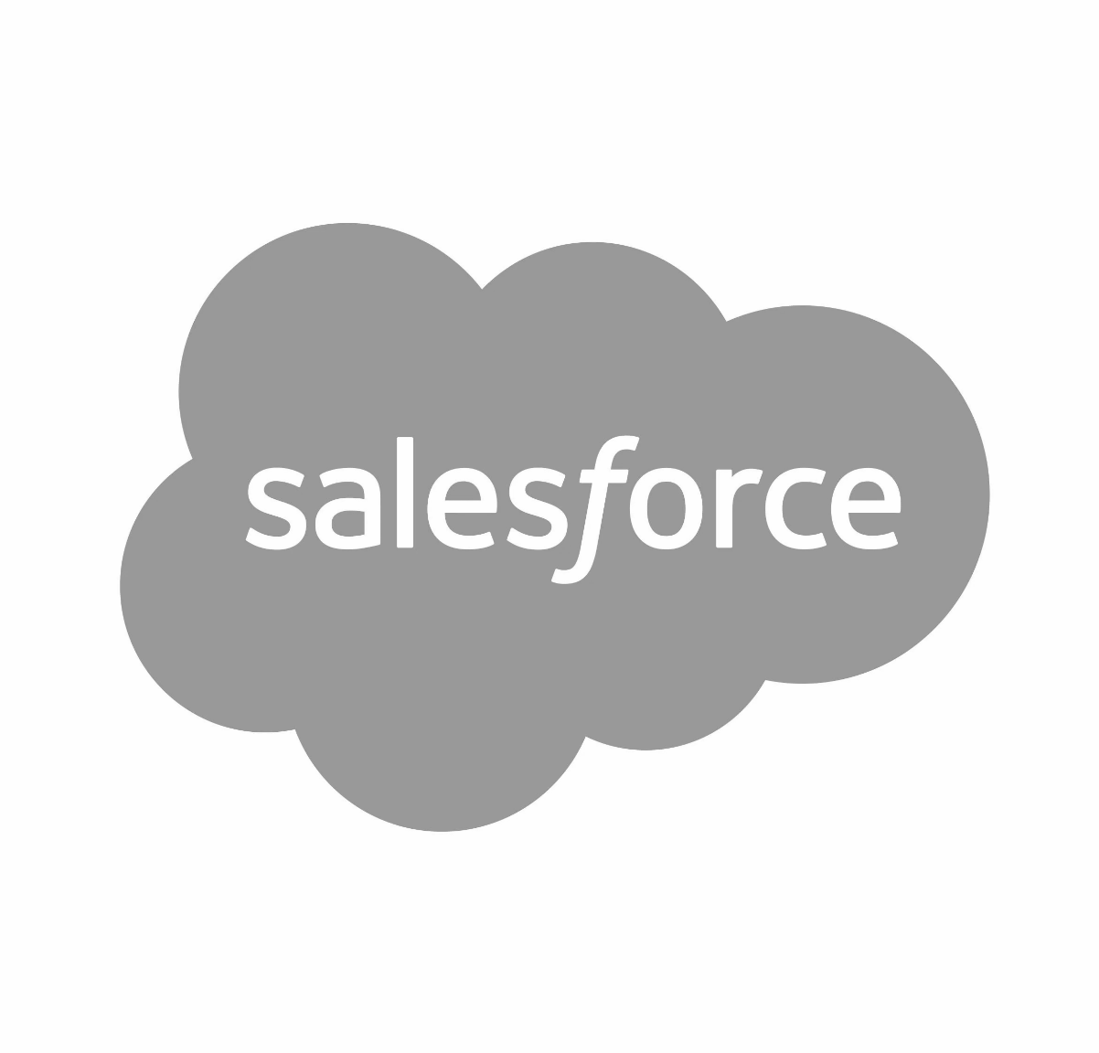



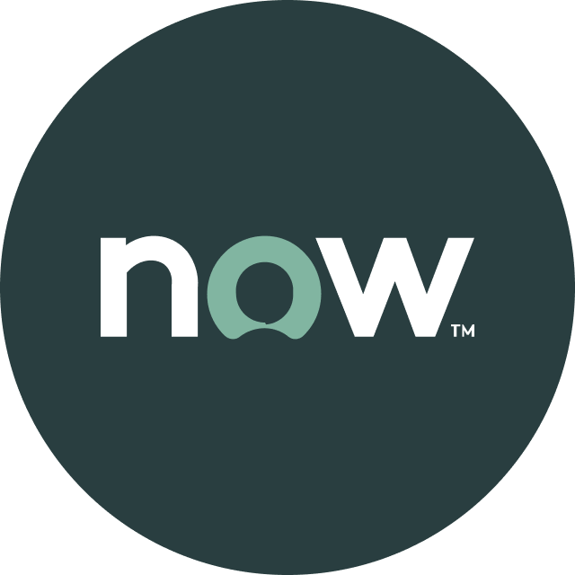


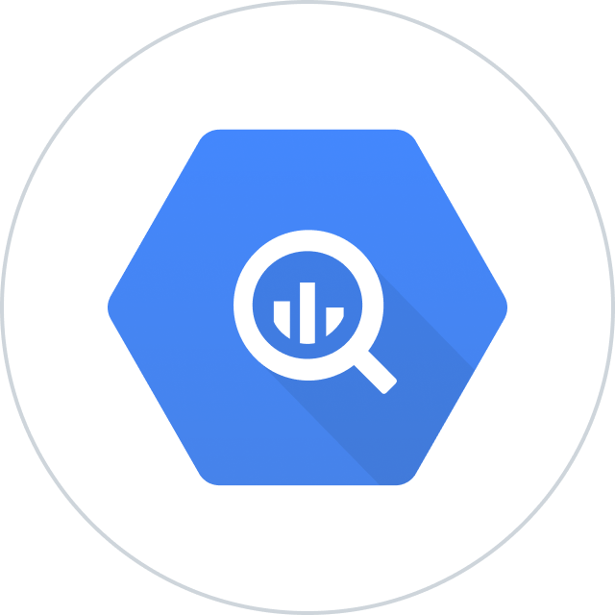


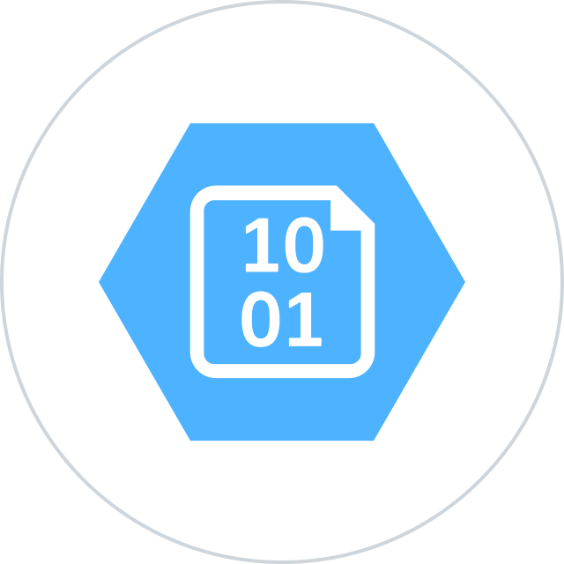


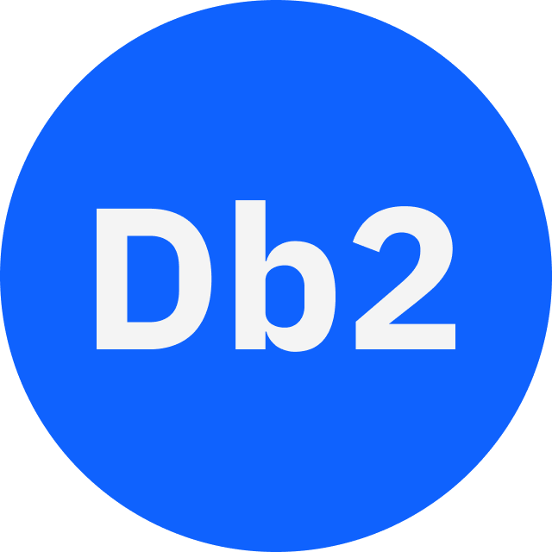




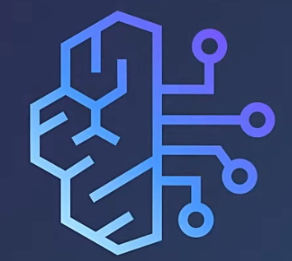
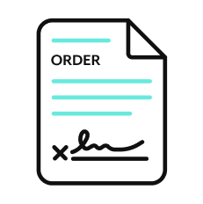

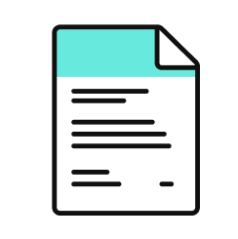
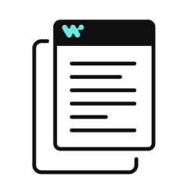




Orchestration for the Agentic Era—Powered by the #1 iPaaS.
I
Build agents with us
Go faster with Enterprise Skill packs and Workato Genies
W O R K A T O E N T E R P R I S E M C P
P L A T F O R M A G E N T S
E N T E R P R I S E S K I L L S
T R U S T
MCP Gateway
Observability
New simpler graphic
Solution Architect (AIRO™)
Skills Builder
MCP Composition
MCP Registry
MCP Proxy
Governance
O R C H E S T R A T I O N
Security
Data Scientist (Acumen)
Process Automation
Application Integration & B2B
Compliance
Data Orchestration
API Management
Explainability
Powered by iPaaS+
U N I V E R S A L C O N N E C T I V I T Y
SaaS/On-prem
Data Warehouse/ Data Lakes
Databases
LLMs
Unstructured
Traditional
Invoice
Media
Transcripts
Contracts
SFTP
Mainframe
Custom
Archives
Notes:
This is Workato ONE —Orchestration for the Agentic Era—Powered by the #1 iPaaS.
Unlike solutions that give you pieces of the puzzle, Workato ONE delivers the complete agentic enterprise:
Workato ONE One platform for data, apps, and agents
Workato GO puts enterprise search with Deep Action™ directly in every employee's hands
Workato Agentic builds and deploys production-ready agents with full enterprise context
Workato Enterprise MCP One trusted bridge for every agent to connect to applications and systems safely and securely
Workato Orchestrate powers complex workflows across teams, systems, and agents
All built on universal connectivity to 10,000+ applications and data sources
What makes this different? True Enterprise Orchestration.
Everyone talks about integration—APIs, MCP, basic workflows. But enterprise orchestration is fundamentally different. It's:
Transactionality that ensures every action completes or rolls back cleanly
In-sequence and exactly-once delivery so your financial transactions never duplicate
Runtime authentication and RBAC that enforces your security policies in real-time
PII obfuscation and data governance that maintains compliance automatically
Event-driven, batch, and real-time triggers that handle any integration pattern
Plus something no one else has: 1 million+ Enterprise Skills—pre-built, production-tested capabilities that encode your business logic, not just API calls. When an agent needs to "process a return," it doesn't just update a field—it orchestrates the entire business process across systems, with all the exception handling, approvals, and compliance checks your enterprise requires.
This unified approach enables true multi-agent orchestration. Your agents don't just connect—they inherit your enterprise's operational intelligence.

Slide 13

Thank you

Slide 14
Appendix of slides

Slide 15
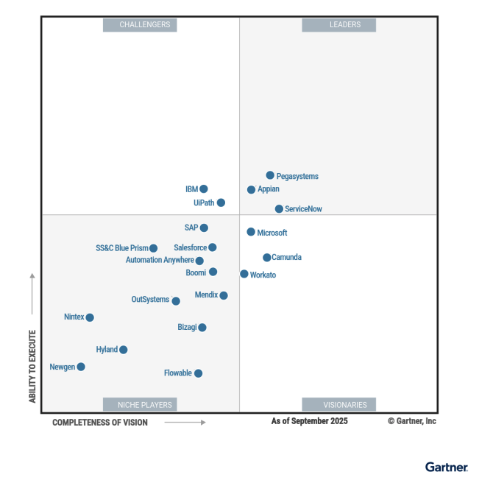
Leader in platforms and orchestration
Gartner iPaas : Leader - 7x
Visionary

